Slide 1
Re-Think Mobile… Beyond Mobile-First
Oracle Mobile Strategy and Overview
Craig Mikus, CPA
Enterprise Mobile Strategy and GTM
“If you don't have a mobile strategy,
…you don't have a strategy for growth”
Eric Schmidt, Google Executive Chairman
Notes:
Questions on this deck, please contact: Rimi Bewtra: rimita.bewtra@oracle.com
PLAY Opening video: https://www.youtube.com/watch?v=ELMDHxq9XNE&list=UU9uW-U8pSZLDDyMnpIZxUkA

Slide 2
Notes:
As per policy I have to have this slide which I am sure you will see a 100 times or more in the next few days.

Slide 3

Agenda
1
Why Do Anything?
Transform the Enterprise
Re-Think Mobile
Simplify Enterprise Mobility
The Future of Mobile … What Next?
2
3
4
5
Notes:
Main Points: Mobile and specifically enterprise mobility topic continues to be the topic on everyone’s mind. In today’s session and Mobile track we will go through the following agenda sections:
Transform The Enterprise – discuss how mobile is playing a key role in the digital and or mobile transformations across industries, with organizations large and small around the world
Rethink Mobile – discuss what we have learned especially in the past decade and discuss why it is time to Rethink Mobile … and look to thinking beyond having a Mobile-first strategy,
Simplify Enterprise Mobility – discuss Oracle Mobile’s core value proposition and strategy to simplify enterprise mobility.
In the Future… What next? – discuss where we are going … how Oracle is continuing to invest in mobile platform to simplify enterprise mobility
Let’s get started.

Slide 4



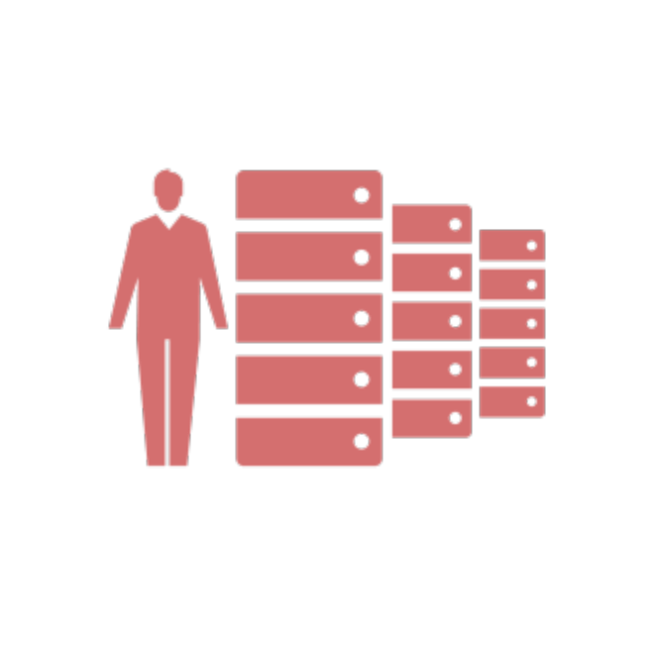



Why Do Anything?
Trends & Market Drivers
Business Goals
Challenges
Rapid proliferation of mobile devices
Mobile everywhere (tablets, phones, wearables, appliances)
Bring Your Own Device (BYOD )
Customer experience and loyalty
New revenue streams
New business processes
Competitive Differentiation
Productivity & Efficiency
Agility
Integration to systems of records
Security
Device Diversity
Skills
BYOD
4
Notes:
Mobility means from a solution perspective

Slide 5









The Enterprise Evolution or Revolution?
The New Normal
Mainframe
Client/Server
Web
Mobile
Things

Slide 6

Transform The Enterprise
1
@OracleMobile
6

Slide 7

Re-Think Mobility
Mobile App(s)
Enterprise Mobility
Notes:
What I plan to cover this morning is share with you how mobile is playing a key role in the digital transformation, lessons we have learnt, our strategy at Oracle to simplify enterprise mobility and our investment in product and technology that is going to help you invent the future.

Slide 8



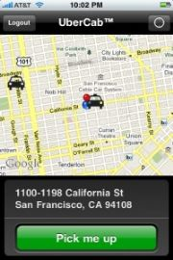

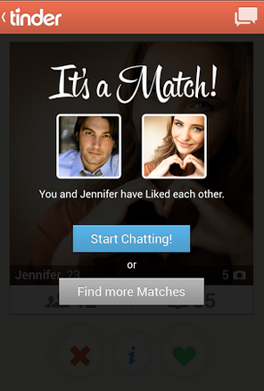
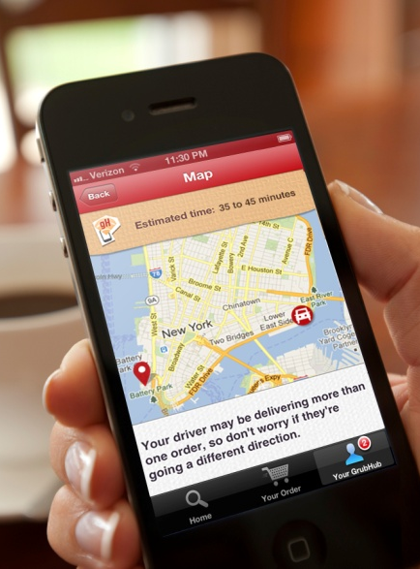
Creating New Mobile First Business Models… Challenging Old Business Models
Notes:
Main Point: <this is an OPTIONAL slide and can easily be deleted if timing is an issue, and or if other slides prior to this have been used>
Companies like:
UBER-global, modern day transportation service - Uber is evolving the way the world moves. By seamlessly connecting riders to drivers through our apps, we make cities more accessible, opening up more possibilities for riders and more business for drivers. From our founding in 2009 to our launches in over 200 cities today, Uber's rapidly expanding global presence continues to bring people and their cities closer.
Tinder: The dating app … Tinder is the dating app that came out of nowhere and now completely dominates the UK dating scene -- Read more at http://www.marieclaire.co.uk/blogs/543941/tinder-the-online-dating-app-that-everyone-s-talking-about.html#KVWPgiTQmr0qF5d1.99
GrubHub: GrubHub Inc. is the nation's leading online and mobile food ordering company dedicated to connecting hungry diners with local takeout restaurants. The company’s online and mobile ordering platforms allow diners to order directly from approximately 30,000 takeout restaurants in more than 700 U.S. cities and London. Every order is supported by the company’s 24/7 customer service teams. GrubHub Inc. has offices in Chicago, New York and London.
These companies have built their business with a mobile-first strategy and their livelihood depends on the success, convenience of their Mobile Apps.

Slide 9

Behaviors have evolved
Always on, always sharing, always aware.
Notes:
Main Point: Our behaviors have evolved – today we cannot live without mobile devices.
I am sure we we all have had a mobile moment where we needed urgent access to something and we have whipped out our mobile device and said – thank – fill in the blank (your super power) in my case Steve Jobs for inventing this SmartPhone. “A shout out to Martin Cooper who really invented the brick who I met a few years back when I worked for Motorola.”

Slide 10

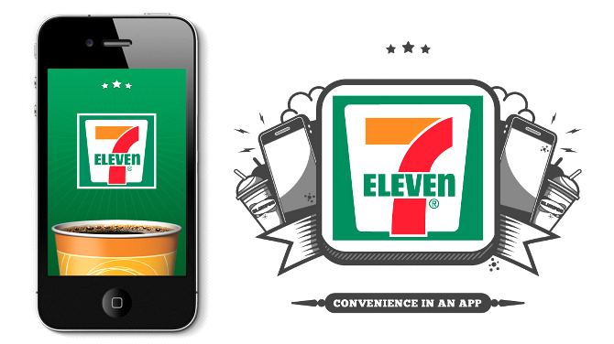
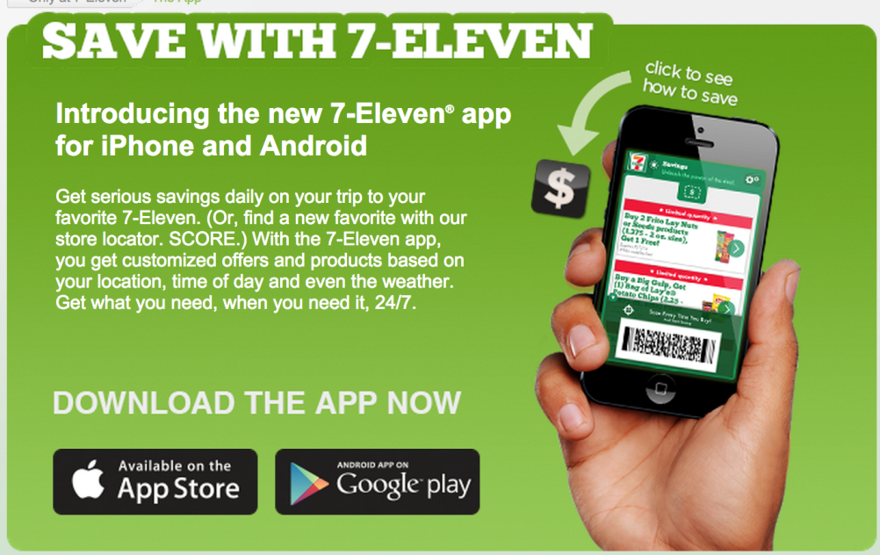
Connected Consumer
Transforming Convenience
Customer Convenience AT YOUR Fingertips
The 7-Eleven App keeps up with you, customizing and personalizing your experience from the minute you open it.
Notes:
Opportunities & Challenges
7-Eleven had a vision for transforming their basic mobile app into a sophisticated marketing tool
Solution
Services layer: Oracle SOA Suite, Oracle WebLogic Server, API Gateway, Oracle Services Bus, Oracle Traffic Director, and Exadata and Exalogic
Results
Connect to Customers In and Near Stores
Standardized, secure, on-premise Mobile Backend-as-a-Service (MBaaS) platform – including integrations to non-Oracle SaaS Marketing platform and point-of-sale system
7-Eleven’s new mobile app is live now and in the process of rolling out to all of their stores

Slide 11

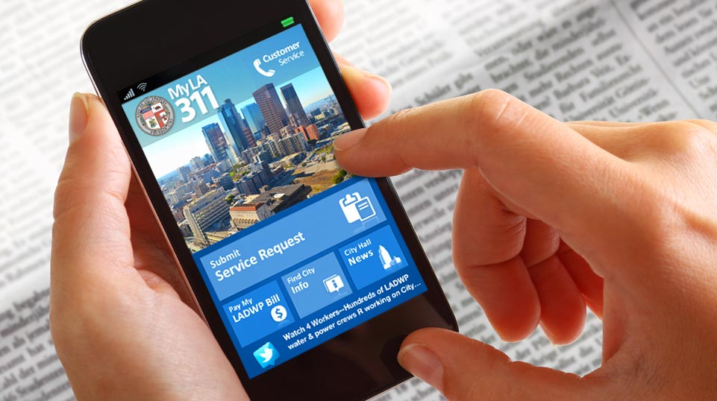
Connected Community
Transforming the City
Connected Community
MyLA311 puts the power of an open, smarter, more accessible City Hall in the palm of your hand.
With MyLA311, City of Los Angeles information and services are just a few taps away.
Notes:
Main Point:
My LA 311 puts the power of an open, smarter, more accessible City Hall in the palm of your hand.With MyLA311, City of Los Angeles information and services are just a few taps away.• The ‘Submit Service Request’ feature allows you to quickly and easily request the City’s most popular services, including graffiti removal, pothole repair, and bulky-item pickup .• Looking for the nearest park? Want to cool off on a hot day? Need to return a library book? The ‘Find City Info’ feature conveniently maps the closest parks, libraries, fire and police stations, golf courses, public pools, tennis courts, golf courses, parking lots, and more.• You can keep up to date with the latest City Hall news by browsing through our Facebook, Twitter and YouTube feeds.• No more stamps and envelopes needed! MyLA311 also allows you to pay your Los Angeles Water and Power bill right from your mobile device.MyLA311 links Angelenos with the services and information they need to enjoy their city, beautify their community and stay connected with their local government.
E-Services portal for 311, Department of Water & Power, Dept of Building and Safety services
Multi channel access (Desktop, Mobile, Tablet)
LA Department is one of the largest customer self-service portals in the utility industry
LA DBS portal for online permit approval processes apply for Permit online

Slide 12

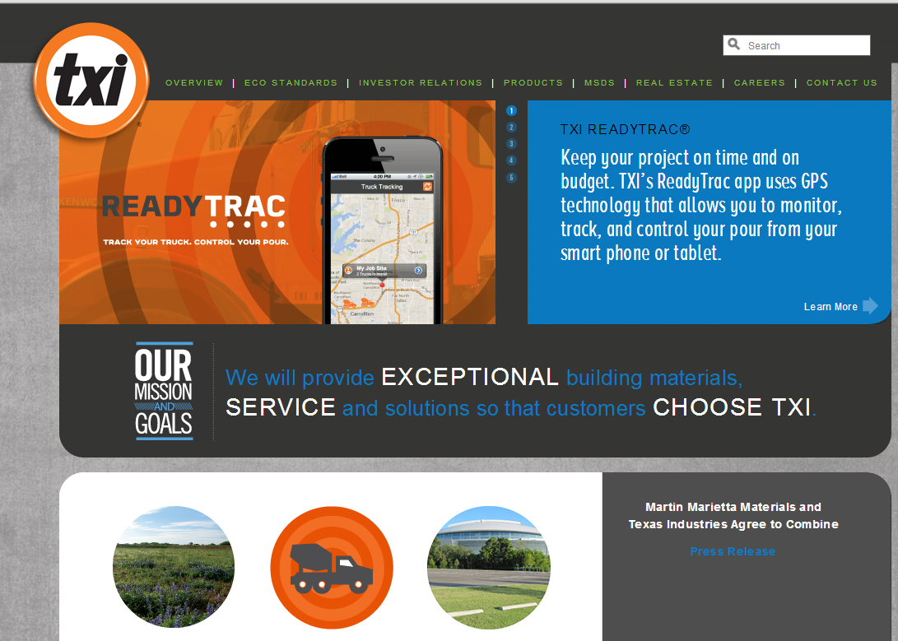
Connected Suppliers & Customers
Connected Suppliers
READYTRAC provides customers with access to real time delivery information.
Delivers online information -- enables managers, superintendents and dispatchers to track ready-mix orders on a real time basis.
Access to crucial order information, customers are able to improve crew efficiency and productivity by allocating on site resources accordingly.
Notes:
Main Point: TXI – Texas Industries
Primarily supplies Cement, Aggregates and Concrete in Texas and Louisiana markets.
Largest cement producer in Texas and a significant supplier in California
Annual Revenues approx. $900mil
Employs 2200 people
Trades under ticker “TXI” on NYSE
Largest cement producer in Texas and a significant supplier in California
Goal: Empower Employees and Customers
Solution: Oracle ADF Mobile (Jdeveloper IDE), Oracle WebLogic Server, Oracle Database, REST/JSON Web services & integration to device features, other applications
10 weeks mobile app development, 1.5FTE
The REST web services were already in place (one codebase for website and app).
Job site supervisors can plan, view of future orders and send out push notification alerts
Footprint:Oracle ADF Mobile (Jdeveloper IDE), Oracle WebLogic Server, Oracle Database 11g, REST/JSON Web services
Other Technologies include Google Maps, Trimble for Real time Location and Command Alkon Dispatch Application.

Slide 13


Connected Enterprise
Transforming the Productivity
Empowered Employees, 24/7
“We wanted to move beyond productivity and efficiency gains to mobilize sales order fulfillment, inventory management, and centralized content management delivery.”
Notes:
Main Point: http://www.oracle.com/us/corporate/profit/partner-news/092712-partner-medtronic-1855120.html.
Can Play the video
The increasing ubiquity of mobile devices led managers at Medtronic, the world’s largest innovator of medical technology solutions, to conclude in 2010 that tablets could greatly benefit their enterprise—if they were coupled with the right mobile applications.
Prescription for Success: Medtronic’s mobile solution empowers the sales force with real-time information.
“We immediately saw benefits from the iPad’s long battery life and being able to use its large screen real estate to tell our story and talk about our products and therapies,” says Jim Freeland, senior principal IT mobility analyst and Enterprise Mobility Team lead at Medtronic, recalling the company’s decision on a mobile strategy. “But we wanted to move beyond productivity and efficiency gains to mobilize sales order fulfillment, inventory management, and centralized content management delivery.”
Since then, Minneapolis, Minnesota–based Medtronic has purchased nearly 13,000 iPads for team members and created an internal app store to support the devices. The store, which is hosted on Oracle WebCenter solutions, has more than 100 mobile applications. One of the most revolutionary is the mobile content management system (mCMS).
Working with another Minnesota-based company, Oracle partner Fishbowl Solutions, Medtronic’s IT staff extended the company’s Oracle WebCenter content-based system, enabling mobile management and distribution of documents. Now, an mCMS for iPad links to Medtronic’s back end, enabling field sales staff to provide current, accurate, and targeted product and therapy information to customers.

Slide 14




The New Frontier . . .
The Connected Consumer
The Connected World …
The Connected Enterprise
Notes:
Main Point: The next frontier for mobile is about much more it is about the internet of things and mobile coming together and creating the Connect Enterprise .. In fact one of say that as our worlds more connected, the consumers demand to be more connected, the enterprise has room to catch up to consumers and the world in how quickly the enterprise gets connected with its employees, customers, partners, etc.
The ability to leverage mobile technology and make it meaningful by finding significant links to multiple, varied sources of data (for example linking biometric values with environmental factors, or calendar data with home control and monitoring) is what will lead to promising developments across industry segments. Oracle understands this and recognizes that the same mobile apps that are developed with Java based tools are now integrated across devices as watches, etc.
I think it’s even bigger than that phrase implies: I believe we’re seeing the beginning of a total connected world, where everyone is connected to everything.

Slide 15

How is Mobile Impacting Your Business ?
Pace of Change
Rapid Development & Time to Market
Customer Satisfaction
ROI
Strategy & Vision
BYOD
Compliance
New Channels
Cost
24/7 Access
Competitive Advantage
Employee Productivity
Customer Loyalty
New Offerings and Services
IT Complexity
Risk & Security
Notes:
Main Point – executives care about these items, not features and functions, or products.
This slide is best told with a story based on an executive conversation around enterprise mobile. Key point is to tie this story/slide into “rethink enterprise mobile”. Past evolutions focused on technology change (mainframe to client server). This tech evolution is about business change.
Discuss impact of Mobile on a customers Business models – how you sell (today and in future), how you interact with your customers and employees, new processes, new services, etc. Mobile devices enable you to leverage technologies like cameras, audio, scanning, scanners, location services, etc.

Slide 16
Re-Think Mobile
2
@OracleMobile
16

Slide 17
Re-Think Enterprise Mobility
Mobile App(s)
Transformation ?!?!
Requires Enterprise Mobile Strategies
Enterprise Mobility
Notes:
What I plan to cover this morning is share with you how mobile is playing a key role in the digital transformation, lessons we have learnt, our strategy at Oracle to simplify enterprise mobility and our investment in product and technology that is going to help you invent the future.

Slide 18

Low Mobile Penetration Enterprise Wide
Active Research/On Radar
33%
19%
Piloting
23%
In production by division
33%
10%
In production enterprise-wide
6%
Upgrading
33%
9%
Not interested
Source: CIO Magazine Tech Poll/Tech . 2014
Sources: Unisys Security Index | Acuity Market Intelligence | MeMD.me Infographic

Slide 19
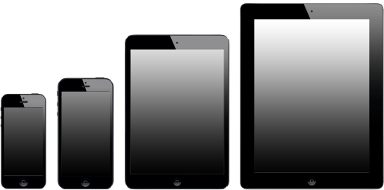





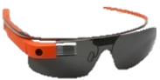
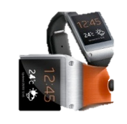
Mobility requirements from the enterprise
Bring Your Own Device
(BYOD)
Multiple Form Factors
Multiple Mobile OS
Enterprise Integration & Security
74% Allow some sort of BYOD usage.
74%
Form
Factors
Securing corporate information
41%
Less than 10% “FULLY AWARE” of the devices accessing their network
Mobile
OS
Integrating with other systems
31%
10%
IoT
Forbes: Mobile Business Statistics For 2012
CIO Insight: Top Challenges of Enterprise Mobility, 2012
Notes:
Main Points: Mobile requirements for the enterprise are demanding on IT and business. A few of the trends around:
Bring your own device (BYOD) is here to stay and IT will need to support it.
Multiple form factors, operating systems, etc.
From enterprise perspective Security and Integration continue to be top priorities.

Slide 20
Current State of Enterprise Mobility
Challenges
Concerns with security breach
Time spent
Updating or releasing Mobile Apps
93% of enterprises are concerned with data loss and other security breaches related to mobile devices
2/3 of the time spent on mobility projects is connecting to, and securing back-end systems
87% of enterprises are updating or releasing mobile apps every 6 months or less
Source: 2014 Triangle Research Survey
Notes:
Main Point: Clearly offers a great deal of opportunities for everyone including the enterprise however there are challenges. In a recent research report Oracle conducted with CIO Strategic Insights and Triangle Research here are some key findings:
93% of enterprises are concerned with data loss and other security breaches related to mobile devices
2/3 of the time spent on mobility projects is connecting to, and securing back-end systems
87% of enterprises are updating or releasing mobile apps every 6 months or less
For more information on the survey you can view the webcast and download the survey paper at www.oracle.com/mobile

Slide 21
Re-Think Enterprise Mobility
Think Mobile interaction everywhere: voice, touch, messaging
Think access to relevant and related information anywhere, anytime
Think securing the data instead of device
Think analysis anytime, enable action in real time
Think accelerated agility, not perfection
CLOUD
cLIENT
context
CONTENT
Notes:
Main Point: It is time to Rethink, it is not just about having a that great looking mobile app and a framework that enables you to develop something quickly --- it is also about the content, context and leveraging the Cloud to deliver, integrate, secure, deploy and analyze the performance of these mobile apps quickly and efficiently. It is time to:
Think Mobile interaction everywhere: voice, touch, messaging
Think access to relevant and related information anywhere, anytime
Think securing the data instead of device
Think analysis anytime, enable action in real time
Think accelerated agility, not perfection

Slide 22

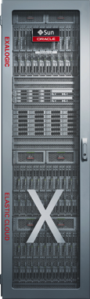
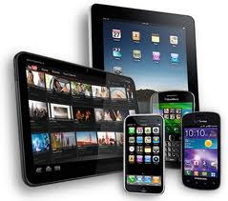
Enterprise Mobility begins with a “Mobile Plus” Architecture
“Device 2 Data Center”
OLTP
Mobile Capabilities
Big Data
Develop
DEPLOY
Integrate
MANAGE
DW / Analytics
Secure
IoT
General Content
Notes:
Beyond Mobile First
Talking enterprise mobile.. You need to address the front end mobile, back-end mobile infrastructure, and data strategy
Front end – who are you users, mobile app architecture (native, web, hybrid) and the skills needed to build these apps, security on the device (SSO, data security), managing the device (or really the applications on the device) depending on your device policies (BYOD, COPE), capabilities leverage on the device (often impacts the client architecture.. Not just the device capabilities like location services, scanning, pics, audio, etc.. But data synchronization for off line usage), App portfolio (how many apps, users), etc.
Backend Mobile - what are you integration policies, types of data your accessing, API’s and who is building & managing those API’s (re-usability, security, skills, etc), security (data security, role based security and how it integrates with the app, security on data in transit, deploy the apps (public app store enterprise app store), governance around all this,
Data strategies – and what you do with the data. Integrating into your OLTP systems, tied in with your big data strategy (lots of data), analytics.. Customer loyalty.. How do you drive personalization based on the data, IoT… how does it tie into your product strategies or hw does the data impact your business processes? What content are you exposing ?
Gartner – 25-30% of your effort on front end…. 70-75% effort on the backend

Slide 23
Simplify Enterprise Mobility
32
@OracleMobile

Slide 24
Simplify Enterprise Mobility
Oracle’s Mobile Apps
(Out of The Box)
Build Your Own Apps
APP
Mobile Security
ORACLE MOBILE Platform
ORACLE’S MOBILE STRATEGY
Notes:
Main Point: ORACLE’S MOBILE STRATEGY is to simplify enterprise mobility. Our complete offering includes a mobile platform that can be used to develop, connect and secure your own mobile apps. In addition, mobile security is integrated with the Oracle Mobile Platform and can be leveraged separately as part of your overall enterprise security architecture. Finally, Oracle and partners continue to deliver new, custom and or out-of-the-box mobile apps every day.

Slide 25







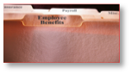
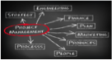





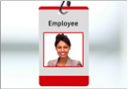
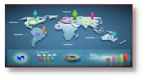













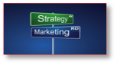


Oracle Mobile Apps Today
… and More On The Way
PeopleSoft
PeopleSoft
PeopleSoft
PeopleSoft
Siebel CRM
Siebel CRM
Siebel CRM
PeopleSoft
PeopleSoft
PeopleSoft
PeopleSoft
PeopleSoft
PeopleSoft
PeopleSoft
PeopleSoft
PeopleSoft
PeopleSoft
Siebel CRM
Siebel CRM
Siebel CRM
EXPENSES
REQUISITIONS
APPROVAL
COMPANY DIRECTORY
PHARMA SALES LIFE SCIENCES
PHARMA SALES REP
OPPORTUNITIES
TIME REPORTING
PROJECTS
TRAVEL AUTHORIZATION
CASH MANAGER
EXECUTIVE HOMEPAGE
LINE LEVEL MANAGER
EXPENSES
REQUISITIONS
APPROVAL
COMPANY DIRECTORY
PHARMA SALES LIFE SCIENCES
PHARMA SALES REP
OPPORTUNITIES
Siebel CRM
Siebel CRM
Siebel CRM
Siebel CRM
Siebel CRM
Siebel CRM
JD Edwards
PeopleSoft
PeopleSoft
PeopleSoft
PeopleSoft
Siebel CRM
Siebel CRM
SERVICE ORDERS
SERVICE REQUEST STATUS
RETAIL EXECUTION CONSUMER GOODS
TPM CONSUMER GOODS
CONTACTS
FIELD SERVICE
EXPENSES
PAYMENT REQUEST
PROCUREMENT OFFICER HOMEPAGE
TIME CARD
BENEFIT PLANS MODIFICATION
CUSTOMER 360
MOBILE KNOWLEDGE
Siebel CRM
Siebel CRM
Siebel CRM
Siebel CRM
Siebel CRM
Siebel CRM
JD Edwards
SERVICE ORDERS
SERVICE REQUEST STATUS
RETAIL EXECUTION CONSUMER GOODS
TPM CONSUMER GOODS
CONTACTS
FIELD SERVICE
EXPENSES
JD Edwards
JD Edwards
E-Business Suite
E-Business Suite
E-Business Suite
E-Business Suite
E-Business Suite
JD Edwards
JD Edwards
JD Edwards
JD Edwards
JD Edwards
JD Edwards
REQUSITIONS
PO APPROVAL
SERVICE ORDERS
TRANSPORTATION
AGILE PLM
REQUEST STATUS
ORDERS
REQUISITIONS
SERVICE ORDERS
PURCHASE ORDERS
PO APPROVAL
SUPPLIER SELF SERVICE
PROJECTS ON THE GO
SAAS HCM
SAAS HCM
SAAS HCM
SAAS HCM
SAAS HCM
SAAS HCM
SAAS HCM
E-Business Suite
E-Business Suite
E-Business Suite
E-Business Suite
E-Business Suite
E-Business Suite
JD Edwards
JD Edwards
E-Business Suite
E-Business Suite
E-Business Suite
E-Business Suite
E-Business Suite
COMPANY DIRECTORY
WORKER PORTRAIT
APPROVALS
RECRUITING
RESUME SCREENING
GOALS
CANDIDATE SCREENING
SUPPLIER SELF SERVICE
PROJECTS ON THE GO
WAREHOUSE INTEGRATION
AGILE PLM
EXPENSES
COMPANY DIRECTORY
REQUSITIONS
PO APPROVAL
SERVICE ORDERS
TRANSPORTATION
AGILE PLM
REQUEST STATUS
ORDERS
SAAS HCM
SAAS HCM
SAAS HCM
SAAS HCM
SAAS HCM
SAAS HCM
SAAS HCM
SAAS HCM
SAAS HCM
PeopleSoft
JD Edwards
E-Business Suite
SAAS HCM
RECRUITING
RESUME SCREENING
CANDIDATE SCREENING
SUCCESSION PLANNING
TIME CARD
INTERVIEW MANAGEMENT
TALENT REVIEW
LEARNING
TIME CARD
MAINTENANCE SERVICE REQUEST
EXPENSES
REQUISITION
APPROVALS
SAAS HCM
SAAS HCM
SAAS HCM
SAAS HCM
SAAS HCM
SAAS HCM
SAAS HCM
COMPANY DIRECTORY
WORKER PORTRAIT
APPROVALS
RECRUITING
RESUME SCREENING
GOALS
CANDIDATE SCREENING
PeopleSoft
PeopleSoft
PeopleSoft
Siebel CRM
Siebel CRM
JD Edwards
JD Edwards
E-Business Suite
E-Business Suite
E-Business Suite
E-Business Suite
SAAS HCM
SAAS HCM
TIMECARD
BENEFIT PLANS MODIFICATION
GUIDED SELF SERVICE
PRM
CLIENTELLING
ASSET MANAGEMENT
WAREHOUSE INQUIRY
EXPENSES
ASSET MANAGEMENT
WORKER ABSENCES
WORKER PORTRAIT
WORKER ABSENCES
REQUISITIONS
Notes:
Main Point: Today Oracle offers many out of the box mobile apps across all of our product lines including E-Business Suite, PeopleSoft, Siebel, JD Edwards, RightNow and other packaged and cloud based apps.
This number of mobile apps only continues to grow as we look into the future.
(the point of this slide is not to look up the exact apps that are available and which are not – this graphic is changing all the time – Oracle’s Applications development team , partners and customers are developing apps all the time – the point of this slide is … if there is not app for something today then there easily can be one tomorrow- Mobile App Development happens in weeks rather than months or years.)

Slide 26
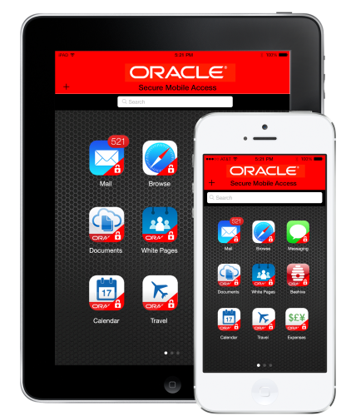









Oracle Mobile Platform
Client, Content, Context, Cloud – Simplify Enterprise Mobility
Multi-Channel
ReThink Mobile
Develop cross platform & multi channel and multi device applications
Integrate data and services across the Enterprise and Mobile devices
Secure information uniformly across all layers of enterprise and mobile apps
Deploy & Manage cloud and on-premises for multi-channel delivery
Native, Web, Hybrid
Oracle Mobile Platform
Develop
DEPLOY
Integrate
MANAGE
Secure
CUSTOM Applications
On-Premise Packaged Applications
Cloud
Notes:
Main Point: As business demands have increased and the workforce has become more mobile, the need for enterprises to ensure users are connected via any device to their enterprise applications, at any time has become more critical. Oracle’s mobile platform addresses this challenge by simplifying application development and allowing developers to securely create and deliver more compelling user experiences. By simplifying this process, enterprises can maximize IT investments and lower application development costs.
Oracle provides One platform that can be used to build any application, securely connect any data source, on any device. The Oracle Mobile Platform provides a common technology framework for building, integrating, securing, deploying and managing mobile apps on any device. It supports a multichannel, multidevice framework that enables you to build apps once and deploy them to iOS, Android and other platforms—with Web, native and hybrid delivery.
Easily define mobile interfaces and APIs, and build mobile applications for your enterprise systems
Extend by connecting mobile developers with enterprise data and back-end services via the cloud
Empower developers, IT, and the business to deliver highly engaging mobile experiences
Develop cross platform & multi channel and multi device applications
Integrate data and services across the Enterprise and Mobile devices
Secure information uniformly across all layers of enterprise and mobile apps
Deploy & Manage cloud and on-premises for multi-channel delivery
The Oracle Mobile Platform is built for reliability, manageability and scalability across both large and small-scale enterprises. Extending Oracle Identity Management to mobile, enterprises can bridge the security gap between the enterprise and mobile devices by focusing on securing, controlling and managing the apps that run on these devices through a secure mobile app container to isolate corporate access and data from employee’s personal apps on popular mobile devices without compromising the rich user experience.

Slide 27
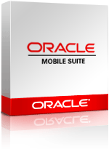


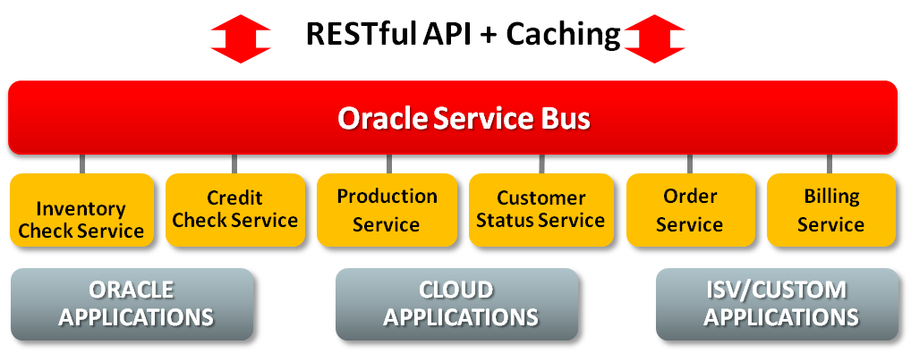
Oracle Mobile Suite:
Simplify Enterprise Mobility with Complete Offering
Mobile Application Framework
Mobile Integration
Oracle Mobile Suite
Single Source, Cross Platform
Integrated Security
Extensible Visual Components
IDE Choice – Eclipse + JDev
Access to data& services across the enterprise & external sources
Reliable & proven orchestration platform
A complete development & deployment platform to extend enterprise systems to mobile.
Notes:
Main Point: In addition to delivering a complete solution, Oracle is committed to simplifying enterprise mobility. In Calendar year 2014, we released Oracle Mobile Application Framework and Oracle Mobile Suite.
As organizations strive to support an increasingly mobile workforce, application developers are challenged to keep up with demand across multiple mobile platforms. Empowering developers to create new, highly scalable, secure mobile applications faster and in an easier way, as part of the Oracle Mobile Platform, Oracle has released new innovations with Oracle Mobile Suite, which includes the new Oracle Mobile Application Framework (MAF) with an updated version of Oracle Service Bus optimized for mobile integration including native support for REST/JSON APIs. These enhancements enable customers to accelerate the delivery of new cross device mobile applications with access to on-premises, cloud and third party mobile services.
“Oracle Mobile Suite contains everything developers need to extend their enterprise systems to mobile phones and tablets,” said Chris Tonas, vice president, mobility and development tools, Oracle. “The new Oracle Mobile Application Framework offers an easy transition for Java developers to bring their development skills to the mobile world, leveraging their Java and JavaScript skills with the tools they already use. By integrating the mobile application developer experience on both the front and back end, we are helping developers deliver mobile applications to their organization faster and more efficiently.
Oracle Mobile Application Framework (MAF) designed to simplify the development of multiplatform on-device mobile applications.
A new version of Oracle Service Bus, a core component of Oracle Mobile Suite, provides the foundation for an agile multi-channel and more specifically mobile strategy. Oracle Service
Bus 12c simplifies mobile enablement by allowing backend applications, on the cloud or on-premises, to be exposed through JSON (JavaScript Object Notation) and REST (Representational State Transfer) APIs.
Oracle MAF is tightly integrated with Oracle Mobile Security Suite, which secures corporate-owned applications and data on mobile devices, and secures deployment and management of any mobile application.
Oracle Mobile Suite, an integrated solution designed to accelerate development and deployment of mobile applications across multiple mobile platforms, and that works with disparate enterprise systems.
For details: see press release at: http://www.oracle.com/us/corporate/press/2231841
Data sheet at: http://www.oracle.com/us/technologies/mobile/oracle-mobile-suite-ds-2085011.pdf

Slide 28
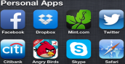



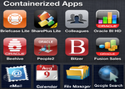


Oracle Mobile Security Suite:
Securely Separate And Manage Corporate Apps And Data On Devices
/
CONTROL
EXPERIENCE
CONTAINER
Isolate corporate data, support remote wipe, restrict data transfer
Secure applications & communication, corporate application store
Role based access, self service request, sign-on, fraud detection
Notes:
Main Point: From the BYOD perspective, Oracle is focused on three things:
Providing a secure container for IT owned apps and data, including the ability to add new applications to this container, that is separated from personal apps and data
Enabling secure connection and management of these mobile applications, including the ability to wipe apps and data without affecting personal data
Extending Identity services to these mobile applications so that users have the benefit of single sign-on and consistent entitlements across channels
Oracle Mobile Security Suite: Secures corporate applications and data on personal devices used for work purposes (BYOD) and delivers a consistent user experience across channels by extending identity services, such as fraud detection, user registration, access request, self-service password management and authorization management, to customer and employee digital interactions. Enables organizations to secure consumer facing mobile apps, distributed through popular app stores.

Slide 29






























Oracle Mobile Customers and Partners
Notes:
Main Point: Just a few of the customers and partners using the Oracle Mobile Platform.

Slide 30
The Future
432
@OracleMobile
30

Slide 31
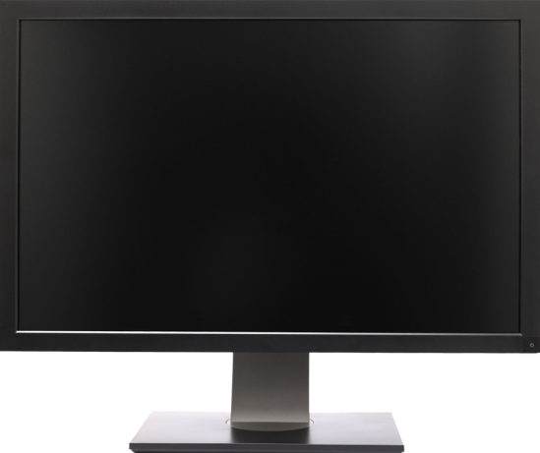
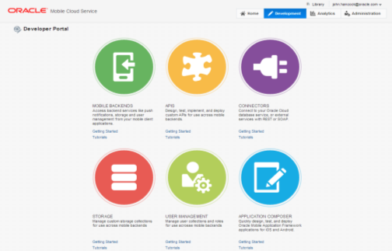
Oracle Mobile Cloud Service
Mobile First meets API First
USE PRE-BUILT Mobile SERVICES
Agnostic to client development tools
Create & Expose New Services & API’s
Integrated Security
ANALYZE & MEASURE Business impact
Built in continuous delivery SDLC
Notes:
Main Point: The Oracle Mobile Cloud Service goal is to easily enable mobile application developers that are continually looking for new ways to accelerate development of apps to meet their consumers’ needs. MCS will be a set of cloud-based, server-side mobile services to make app development quicker and easier to deploy. MCS reduces the complexities of the application development by dealing with the complex server side programming, reducing the redundancy in creating backend code blocks, providing ready to integrate features and template backend.
Developers can focus more on the front end of the applications and can have their choice of mobile client development tools including ADF-Mobile for cross platform hybrid apps, native development or other Javascript tools – creating a new meaning for BYOD – Bring your own development
MCS provides a set of rich RESTFul interfaces for all the operations required by the mobile app that abstracts the backend from the mobile developer. In addition it also provides mobile specific interfaces for notification (multi channel – app, SMS), offline data sync, persistence services (to store mobile generated data and user preferences) as cloud data storage service.
From a backend perspective, MCS provides all the tools required by API developers to expose and shape the services to be consumed by the mobile developer. This includes mechanisms to design, create and expose these services in a catalog that can be easily and securely discoverable by mobile developers and integrated into their app.
Security is a critical component and is designed ground up in the MCS. From tokens to developers to develop and consume APIs to encryption policies for data in rest, data in motion, policies for single sign on and federated authentication across multiple data sources via Oauth or SAML and policies for defining access rights to applications via mobile application management or container technologies are services that will be available in MCS
A key component of MCS is to provide developers, IT and business with metrics on service usage and business impact. MCS will be designed to provide technical metrics, engagement metrics, business metrics along with the monitoring and management of the service.

Slide 32
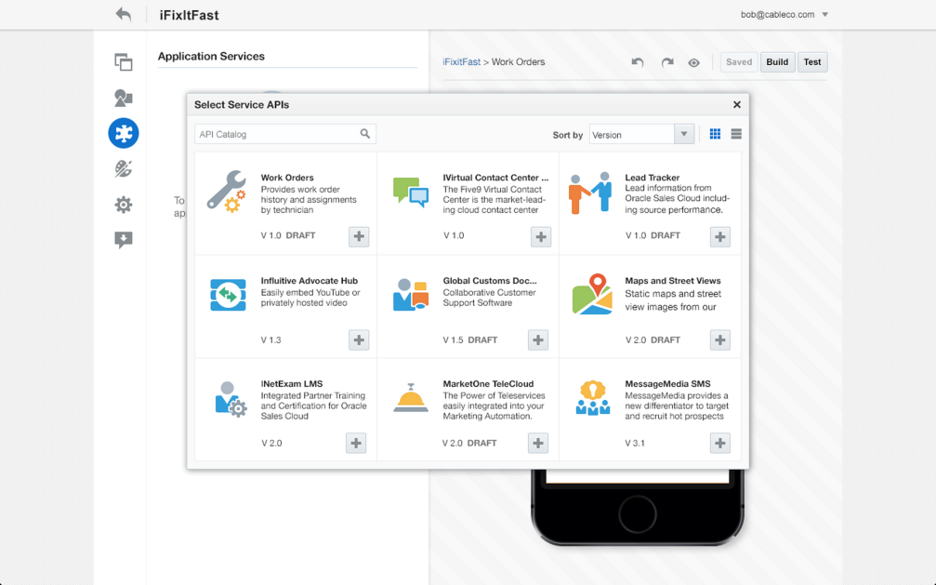
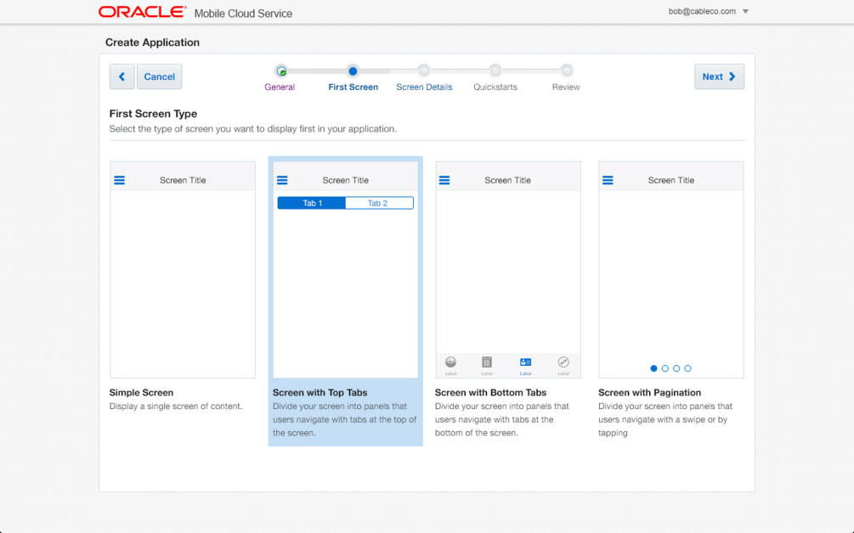
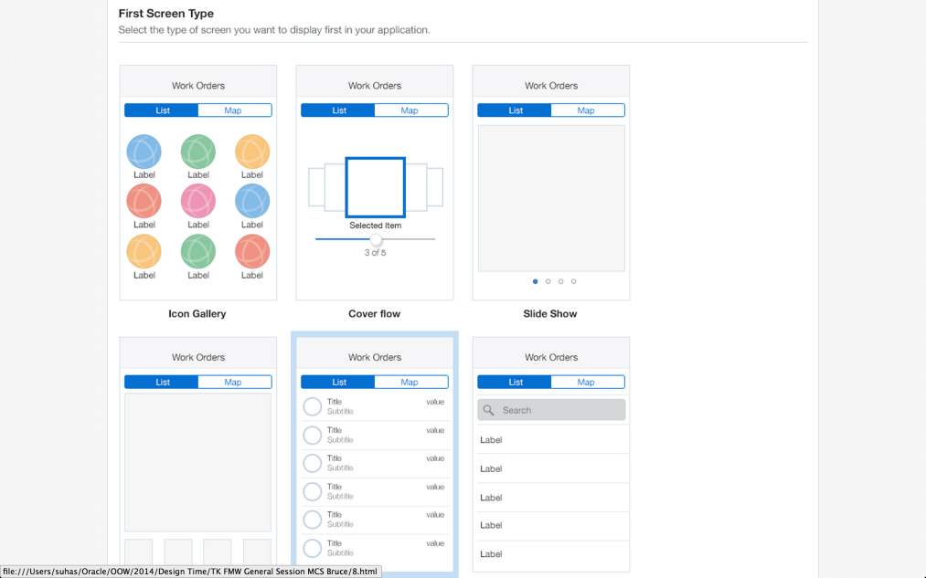
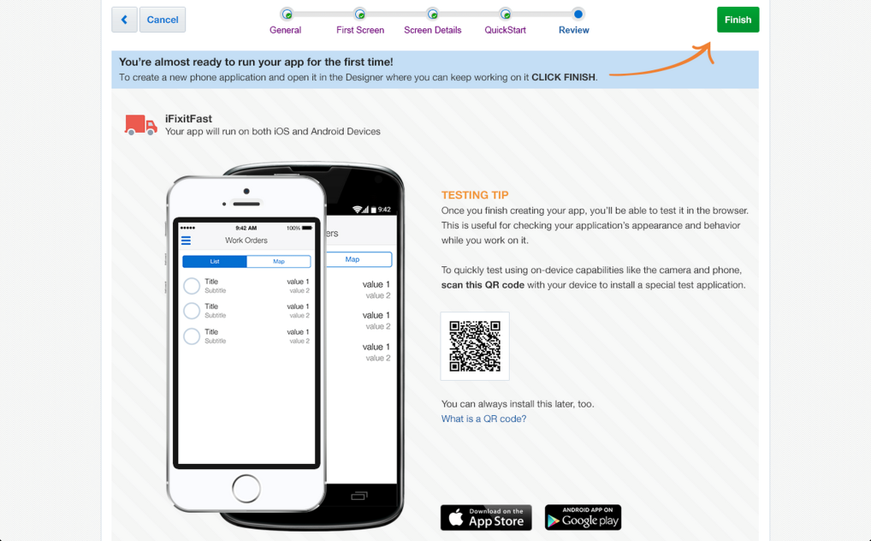
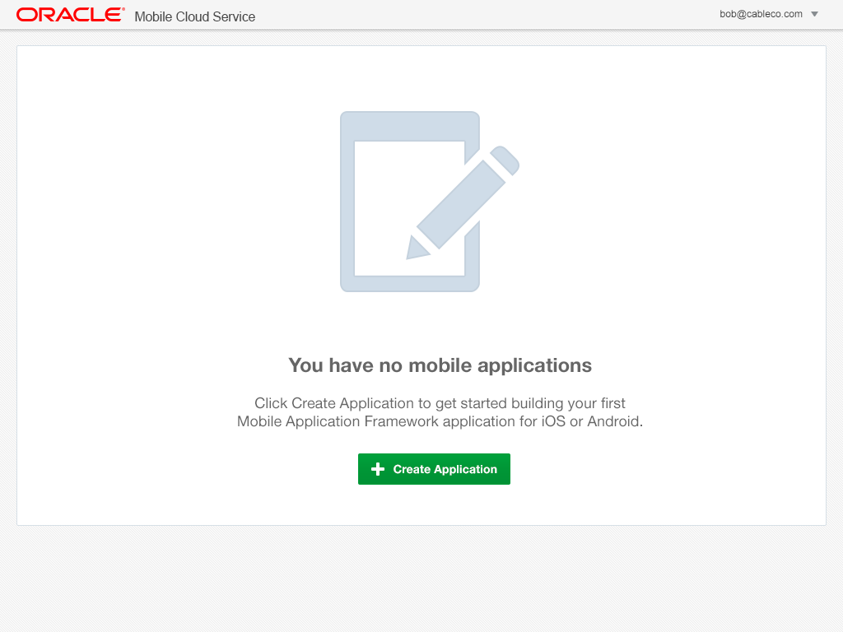
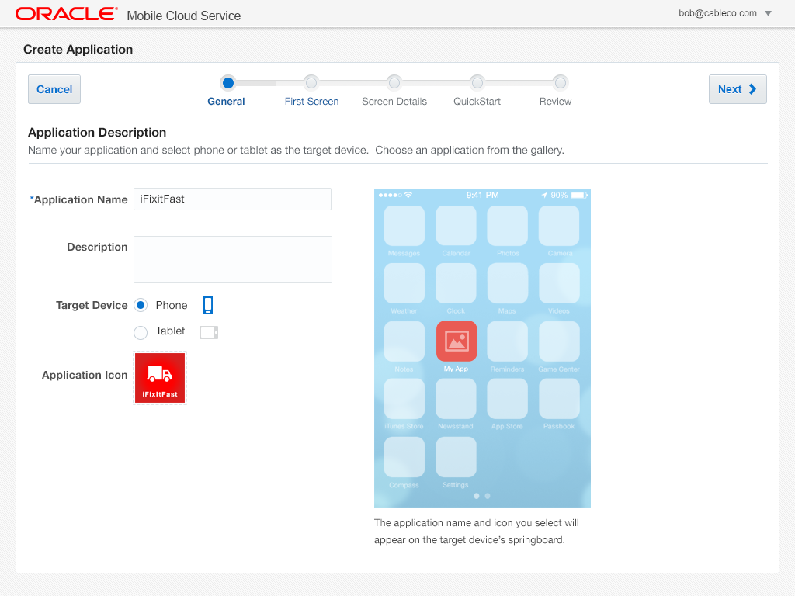
Mobile Application Accelerator (MAX)
Business User Friendly Mobile App Composition in the Cloud
Browser based development
No coding required
Easily map to business services
Preview app in line
Edit, test, and publish from browser
SHOW Demo
Notes:
Main Point: As mobile devices become the primary means for accessing information, enterprises must find a way to accelerate mobilization. For many, the answer lies in giving business-side workers the ability to mobilize their own business processes. To address this requirement, Oracle is announcing the preview of Mobile Application Accelerator, a new capability in Oracle Mobile Cloud Service. Mobile Application Accelerator is a cloud-based offering that brings mobile application development capabilities to professionals with no previous software development experience. With Mobile Application Accelerator, program managers, power users, and business professionals can develop mobile applications quickly and visually through their web browser.
Additional info – if needed. At: Sept. 30, 2014: Oracle Previews Mobile Application Accelerator for Oracle Mobile Cloud Servicehttp://www.oracle.com/us/corporate/press/2313779
Previewed today at Oracle OpenWorld, Mobile Application Accelerator, a new capability in Oracle Mobile Cloud Service, enables nontechnical staff to build their own mobile applications.
Oracle’s Mobile Application Accelerator feature allows users with no coding experience to rapidly and intuitively produce mobile applications without coding.Mobile Application Accelerator provides an instant, live view of the application even while editing, without requiring the typical development and release cycles. No deployment step is required.
The new mobile capability allows users to develop secure, user friendly, and engaging mobile applications that run on both iOS and Android phones and tablets by leveraging Oracle Mobile Application Framework and Oracle Mobile Cloud, part of the Oracle Cloud.
The Mobile Application Accelerator development environment offers the ability to develop mobile applications from both desktops and mobile devices without the need to install mobile development environments.
By giving new classes of professionals the power to create mobile applications, Mobile Application Accelerator reduces users’ ever-increasing demands on IT for mobile access to data and processes.
Based on a set of best practices for UI design, Mobile Application Accelerator makes it possible for users to create mobile applications leveraging multiple page templates and connect them to various back-end systems with Oracle Mobile Cloud.
Developers can use Oracle Mobile Application Framework to further enhance mobile applications created with Mobile Application Accelerator. This capability provides continuity of development tools and framework between power users and developers and increases collaboration.

Slide 33













































“If you don't have a mobile strategy,
…you don't have a strategy for growth”
Eric Schmidt, Google Executive Chairman
Notes:
Main Point: <just read the quote>
"The future of computing is mobile. Schmidt says that businesses should have their best developers working on their mobile applications… interoperability and security of mobile devices will be key factors for large businesses a few years down the road.”
"If you don't have a mobile strategy, you don't have a strategy for growth" Eric Schmidt (CEO, Google)

Slide 34





For More Information
Twitter
Facebook
Blogs
LinkedIn
YouTube
Visit: http://www.oracle.com/mobile
Notes:
With that please join us the rest of the day to learn more about Oracle’s Mobile Solution and our Mobile Platform.
Visit our website to learn more:
www.oracle.com/mobile
www.oracle.com/mobileplatform

